Slide 1
A5 Draft/Script

Slide 2

COVID 19 Economic Impact
GDP plunged 7 per cent in the June quarter, more than three times the previous biggest fall of 2 per cent in 1974
Household expenditure fell 12.1 per cent
With fewer places to spend money the household saving rate jumped from 6 to 19.8 per cent

Slide 3
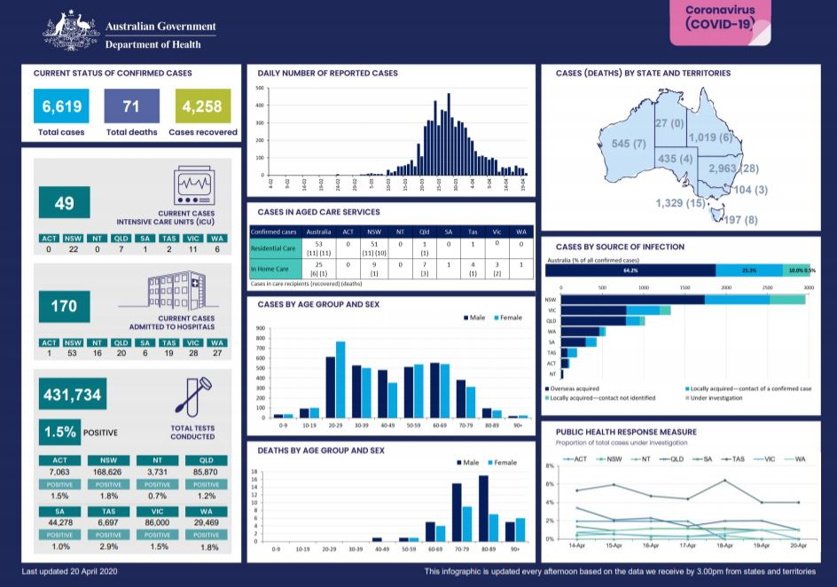
COVID at a glance

Slide 4
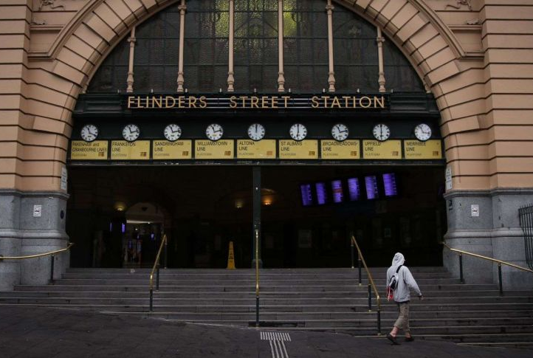
Mandatory Lockdowns

Slide 5
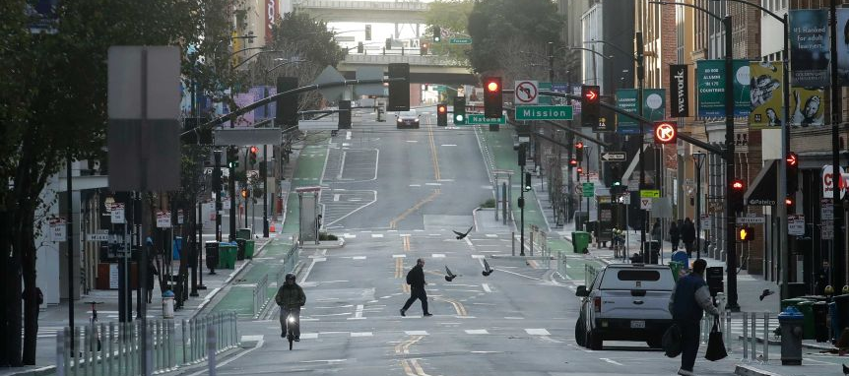
Mandatory Lockdowns

Slide 6

Melbourne

Slide 7
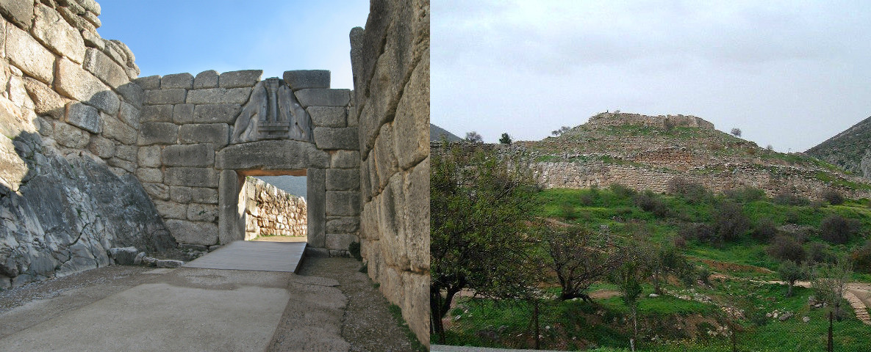
Adelaide

Slide 8
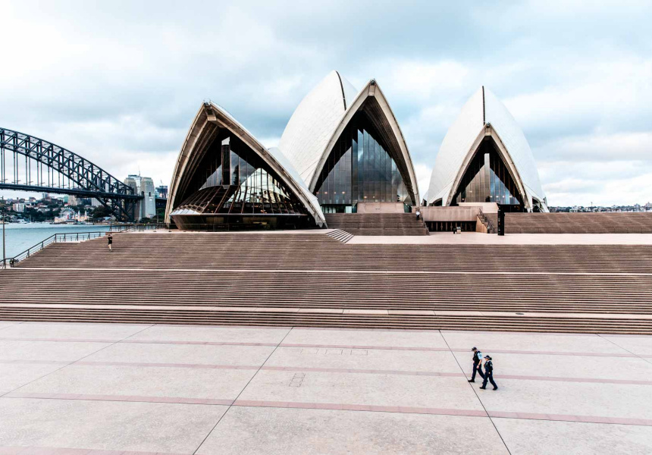
Sydney

Slide 9
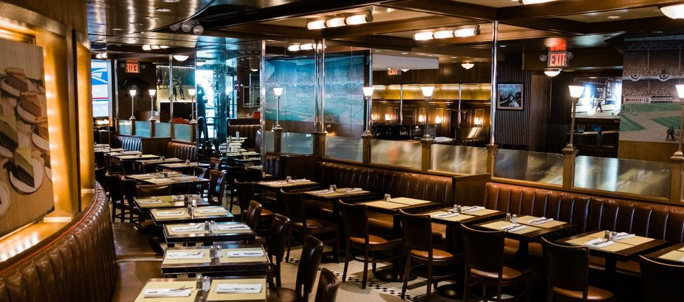
Impact on Hospitality sector

Slide 10
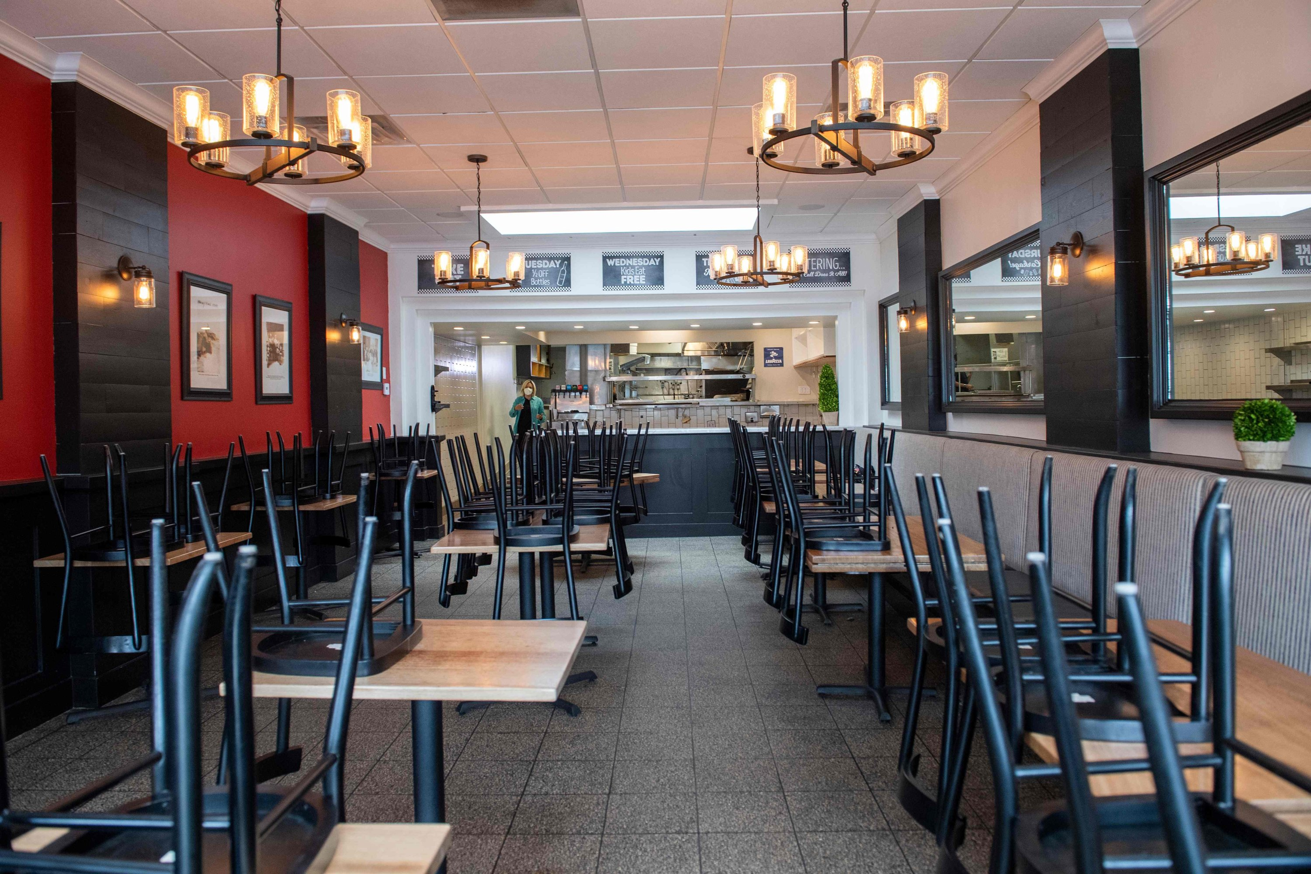
Impact on Hospitality sector

Slide 11

Welcome to SmartOrder®

Slide 12
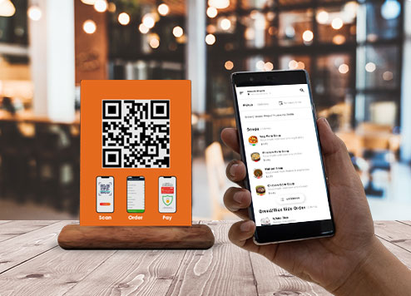
Contactless ordering

Slide 13
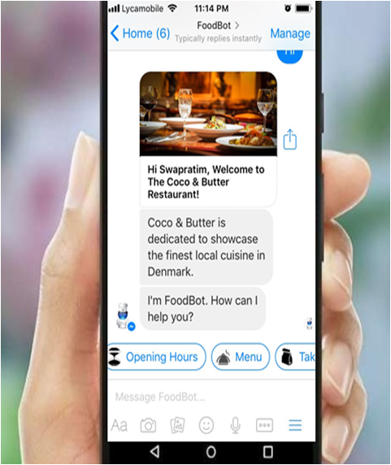
Chatbot

Slide 14


Slide 15

Interview with consumer

Slide 16

Interview with Hospitality worker

Slide 17

Interview with Hospitality Business Owner

Slide 18

Investor information

Slide 19

Meet our Team

Slide 20
References
https://www.abc.net.au/news/2020-09-02/australian-recession-confirmed-as-economy-shrinks-in-june-qtr/12619950#:~:text=Key%20points%3A,6%20to%2019.8%20per%20cent
https://www.hospitalitynet.org/opinion/4098062.html
https://www.pwc.com.au/press-room/2020/the-rostering-report-provides-new-insights.html
https://www.theguardian.com/australia-news/2020/apr/07/coronavirus-crisis-has-had-staggering-impact-on-australian-businesses-data-reveals
https://home.kpmg/au/en/home/insights/2020/05/covid-19-coronavirus-hospitality-sector-next-step.html

